Slide 1
DWS MINISTER’S MEETING WITH WSA’s ON POWERS AND FUNCTIONS
25 JANUARY 2019
BIRCHWOOD HOTEL
THE RECONFIGURATION OF THE TWO-TIER LG SYSTEM WITHIN A LARGER MUNICIPAL POWERS AND FUNCTIONS POLICY FRAMEWORK
Presenter: Ashley Losch
National Department of Cooperative Governance

Slide 2
Purpose of Presentation
To present an overview of the approach to the Reconfiguration of the Two-Tier LG System, within the larger, emerging policy framework on the clarification of Municipal Powers and Functions

Slide 3
The 53rd Policy Conference: Towards More Integrated Cooperative Governance as Part of a Developmental State: Key Resolutions:
There should be a differentiated local government model
Devolution of certain provincial functions to stronger municipalities.
Strong local municipalities to not be located in Districts.
District municipalities should focus on coordinating, planning and support to local municipalities functions.
District municipalities should exist only in areas where there are weak local municipalities
There should be a new funding model for District municipalities

Slide 4
Structure and Governance of the State: LG Policy Context:
54th Policy Conference:
Need for More Integrated Cooperative Governance
Future of Provinces
Differentiated Local Government Model
Role of District Municipalities
More effective governance in municipalities
A review of the Local Government Financial System.

Slide 5
LG and Service Delivery: Policy to Legislation
Section 83(3) provides that:
A district municipality must seek to achieve the integrated, sustainable and equitable social and economic development of its area as a whole.
The White Paper: District government should be given key responsibilities for district-wide integrated development planning, including land-use planning, economic planning and development, and transport planning.
District government should also provide bulk-services where required.
Section 84 (1 provides for the 12 service delivery functions assigned to DMs)
Section 84 (2) provides that LMs have the powers provided for in the Constitution, sections 156 and 229, excluding the District powers listed in S84 (1).

Slide 6
Powers and Functions: Authorisations and Adjustments
Section 85(1) –
Adjustments by
MECs
All functions
except 4
national
functions
Capacity
assessment
and
recommendation
by MDB
Regular review
Section 84(3):
Minster’s
authorisations
No regulatory
Environment
For revocation
/ authorisation
(now under
development)
District
Minister:
Water,
sanitation,
electricity,
municipal health:
from district to local
MEC:
Other functions
from district
to local
or vice versa
Local
Service delivery
agreements also
an option
Local
2-tier Powers and Functions

Slide 7
Managing Service Delivery:
Who does what, where?
Differentiation in the Assignment Framework

Slide 8
TWO KEY DISTRICT TYPES IN PRACTICE AND IN FUNDING MODEL: C1, C2
1. C1: Districts as Development Supporters: re: s83, Municipal Structures Act
Recommendations: Policy and Research:
Strengthen District Facilitation, Coordinating and Planning roles across the district as a whole

Slide 9
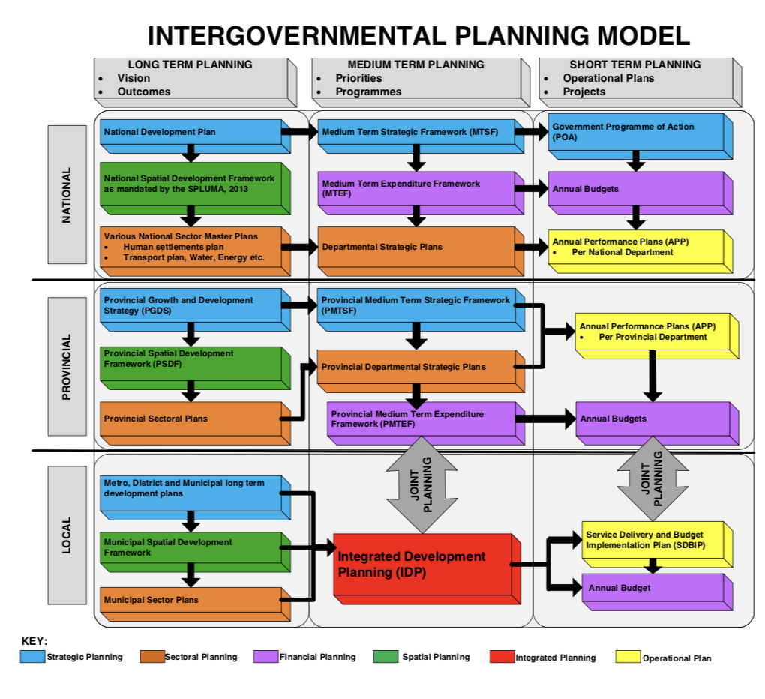
Strengthening S83 District Functions
Districts should focus on their integrated planning, support and coordination roles (supportive district)
‘Predictable institutional mechanism still needed for addressing “Integrated planning, budgeting and coherent implementation in municipal spaces’ (ANC Lekgotla, 2018).
‘Planning is a technically complex activity; many districts have too little capacity to do this well’: District Focus Groups: placed planning in their top five concerns as: ‘Weak planning’ and ‘Fragmented Planning’ respectively
Integrated, aligned, spatially led, sound regional planning will remain central to successful district leadership regardless of how districts are reconfigured.
Source: Draft IDP Guidelines, National COGTA, City Insight.

Slide 10

Coordinating and facilitating urban and regional development planning

Slide 11
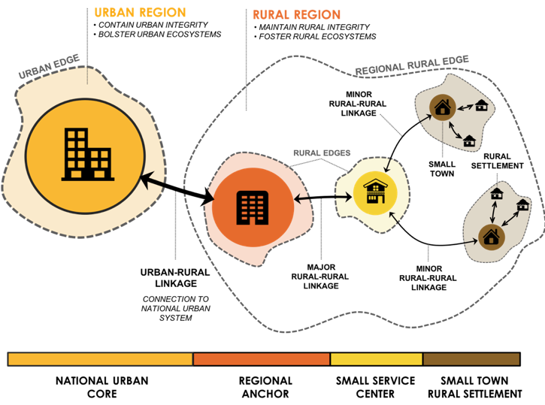
District as Regional Anchor: spatial connectivity, land-use, settlements, transport, economy, environment
Source: Draft NSDF, 2018)

Slide 12
Two-tier Types:
2. C2: Powers and Functions for Service Delivery:
21 WSAs

Slide 13
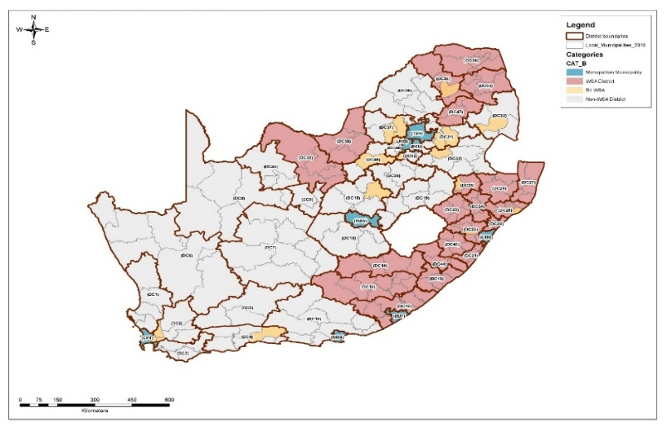
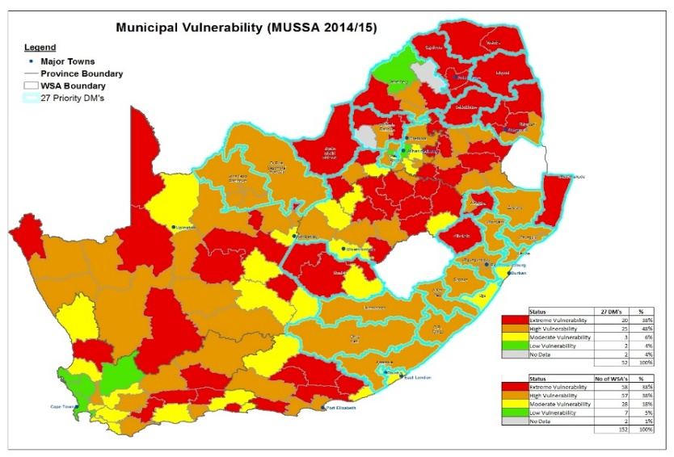
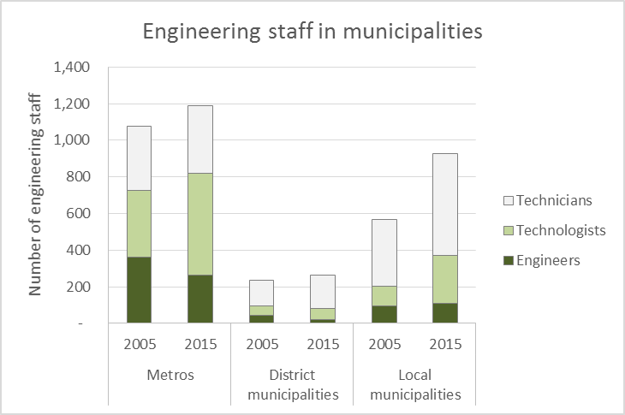
Performance: WSAs
3. Performance of Water Service Authorities
Extreme and High Water Service Vulnerability across all WSAs = 78%
Many of the WSA municipalities “newly” established with little municipal infrastructure in 2000.
WSAs mostly in areas with limited availability of professional, technical and administrative capacity: difficult to recruit and retain qualified engineers.

Slide 14
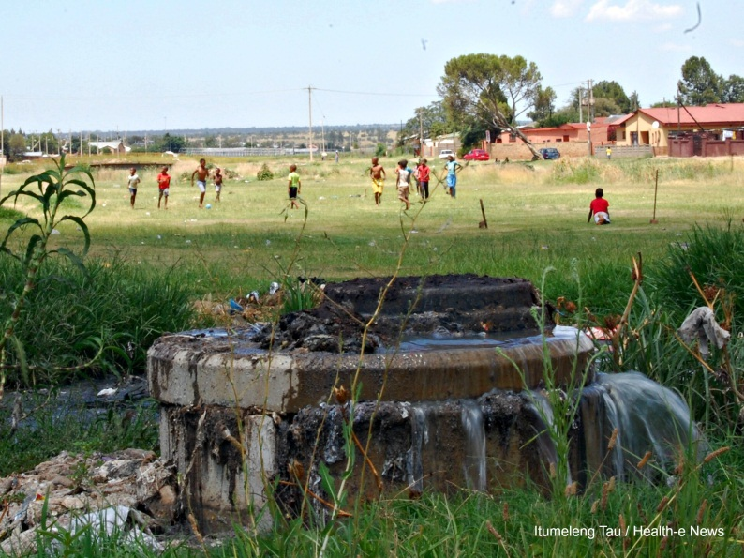
LG AND INFRASTRUCTURE OPERATIONS AND MAINTENANCE

Slide 15
IMTT CONCERNS: MUNICIPAL SERVICE DELIVERY
Municipalities experiencing service delivery challenges and community uprising are characterised by:
  Governance and administration instability and huge municipal debt;
  Poor financial management (and performance);
  Lack of capacity to plan, deliver, operate and maintain infrastructure;
  Service delivery backlogs;
  Poor quality of infrastructure;
  Poor infrastructure carrying capacity;
  Aged infrastructure;
  Poor infrastructure operations &
  maintenance;
  Low services reliability index.
  Fraud and corruption
  Political instability
  Killing of councilors and officials
  Non-viable/dysfunctional municipalities
  Persistent apartheid spatial planning
  Illegal municipal investment in VBS (1,5bn)
Electricity infrastructure is old: needs rehabilitation and maintenance
Non-revenue water loses are costing municipalities almost R10 billion in revenue annually
2013 study of 1179 water schemes showed 9% dysfunctional, 48% needed refurbishment and only 43% in functional state. 38% of water water treatment works required attention and 20%: high failure risk
2014: 57% of waste water treatment plants were in high and critical risk categories with effluent being discharged into rivers

Slide 16
Service Provision and Coordination: Expectations of IMTT on Service Delivery
The Inter-Ministerial Committee on Basic Service Delivery has been involved in a process to integrate more properly the state of service delivery in the country.
This has included assessing, at a local governmental level, what initiatives have been undertaken by government to address infrastructure and services related to water, sanitation, electricity, roads, storm-water, transport, sports facilities, health facilities and educational facilities?
Resolutions have been adopted by the Cabinet Lekgotla and Presidential Coordinating Council endorsing the focus towards monitoring the whole of government service delivery with a view to improving the alignment of governmental delivery and the integration of such delivery into IDPs and similar. This includes also addressing challenges where possible, that require Inter Ministerial cooperation.

Slide 17
Policy Coordination for Investments: Water management and spatial / poverty factors:
Access and supply
Investment decisions
Service Delivery choices
Maintenance, rehabilitation
Enforcement of standards
INSTITUTIONAL DISCONNECTION FROM DWS, DRDLR, DHS?
Rural Water and Sanitation
Informal Settlement Water and Sanitation
Coherent Water Services Investments and Management
Urban Centres Water and Sanitation

Slide 18
The Cost of Dual Administrations
DMs predominantly non-revenue raising entities: grant dependent
Value for Money Issues to be explored: more rationalization, reconfiguration?

Slide 19
E.G.: KZN WSAs: SUMMARY OF BUDGET & SCOPE
WSA | REQUIRED BUDGET | SUMMARY OF SCOPE
UMZINYATHI (MSINGA LM) | R 15,800,000 | 11 new boreholes; Rehabilitation of 100 hand pumps; (includes extension of some reticulation)
MSUNDUZI | R 2,760,000 | 12 new boreholes
UMGUNGUNDLOVU | R 12,487,000 | 52 new boreholes; 31 new static tanks on stands
HARRY GWALA | R 20,000,000 | 89 new boreholes (includes extension of some reticulation); 4 new static tanks on stands; 22 spring protections
KING CETSHWAYO | R 15,300,000 | 51 new boreholes
UTHUKELA | R 38,019,000 | Refurbish 145 boreholes; 72 new boreholes; 11 Spring Protections; 697 new static tanks on stands
UMKHANYAKUDE | R 18,000,000 | 60 new production boreholes
TOTALS | R 122,366,000 | 347 new boreholes; 245 borehole refurbishments; 732 new static tanks on stands; 33 Spring Protections
KZN: cost of eradication of water backlogs: R 78.04 billion

Slide 20
Fiscal Transfers: DMs: approx. 20+ billion per annum
Source: National Treasury, 2018

Slide 21
Percentages of Total Transfers 2018/2019:
Q: What is the money assigned to?
2018/2019: Sample figs:
LGES: (bn) total:
14, 146, 382
C1: = 3,377.815
C2: = 10,768,567
Conditional Grants (bn)
Total: 8,902,048
C1: = 284,891
C2: = 8,617, 157
Sample: C1 / C2 diff: Capricorn: ES: 547,862 (C2)
Waterberg: ES: (C1) 122,853
Source: National Treasury, 2018

Slide 22
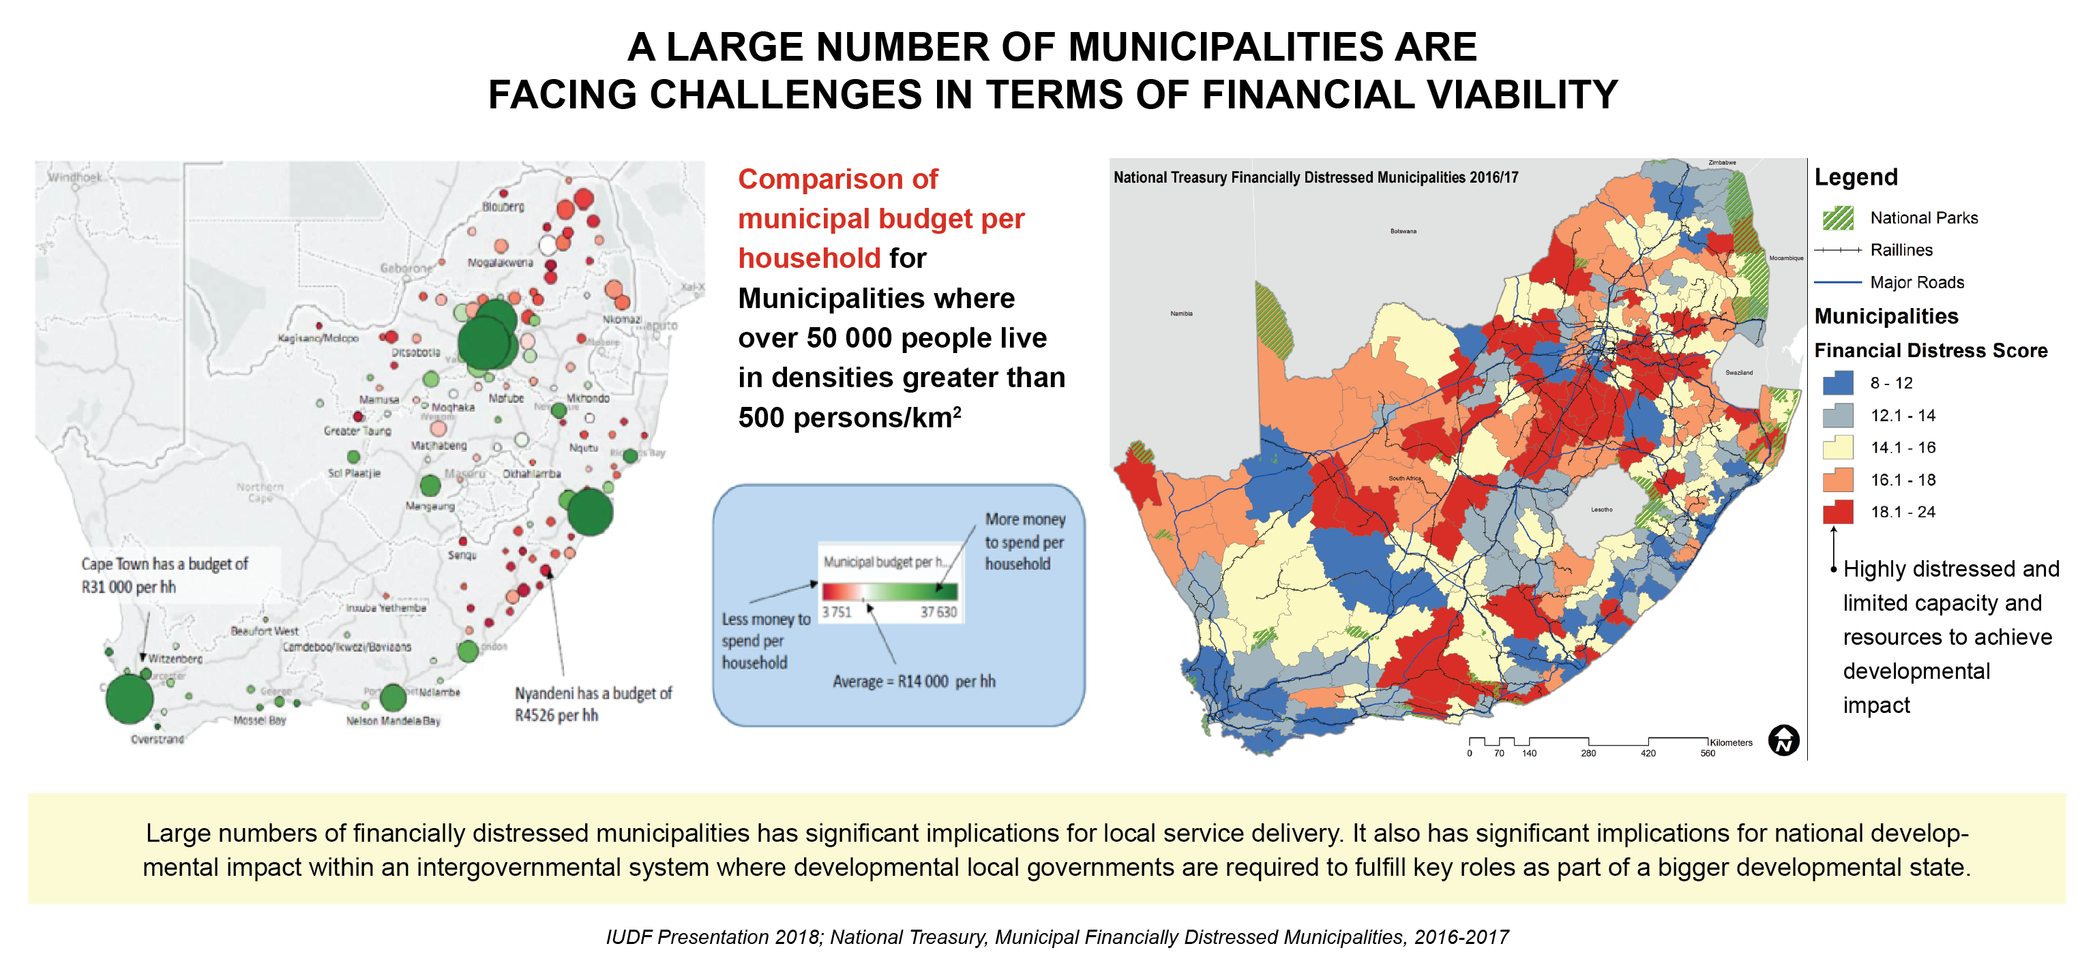
NSDF: Spatial Location of Fiscally Challenged Municipalities: Assess for LG Review

Slide 23
DISTRICTS IN FINANCIAL DISTRESS
Key Observations:
Most DMs have good to fair audit results: why then, are so many in financial distress? Why are red and orange flags raised on leadership, governance, and financial and performance AG controls?
17 DMs as per NT / DCOG monitoring, are in FD: -
12 of these are C2 WSAs
5 of these are C1 DMs
Key Q: What are the root causes of financial distress between C1s and C2s?
(e.g. WSA and other services to be supplied with inadequate resources?; fiscal model for C1s?: disparities in the RSC RG?)

Slide 24
Short-term: Strengthen District support roles for region as a whole √
Short-term: strengthen district service provision capabilities for region as a whole √
Longer-Term:
Disestablish some districts? Single tier LG in urban areas?
Redesign and Restructure LG and re-examine institutional, structural and administrative profiles..√
DISTRICT RECONFIGURATION DEBATES

Slide 25
Reconfiguration: examples / ideas: revising the MSA
FUNCTION | IDEA / PROPOSAL
Municipal solid waste (refuse) service (split function) | Structures Act revisions: make municipal solid waste a single, integrated local municipality function.
Emergency services (fire, rescue, disaster management and ambulance services): Split functions - integrate functions. | Structures Act revisions: make services single, integrated local municipality functions.
Potable water supply systems Domestic waste water and sewage disposal systems (integrated functions WSAs / WSPs, Water Boards, but high vulnerabilities) | WSA Authorisations to be reviewed by the Minister of CoGTA, informed by: DWS Assessments of WSA / WSP functionality MDB Capacity Assessments IMTT / MISA Assessments Revocation and Authorisation Guidelines for Ministerial MSA functions under development by COGTA: 2018 - 2019.

Slide 26
Preliminary Roadmap: RDG: LG Review under Conceptualisation
ACTION | TIMEFRAME
Process to review and revise the Municipal Structures Act: Sections 84, 85: Core roles of DMs Service delivery functions of DMs and LMs Framework for the MEC Adjustment process Revocation and Authorisation Regulations Also option of core basket of services to different LG models | November 2018- November 2019
: Institutional Modelling: LG Review New A2 category, or more clustering / rationalisation of municipalities? Establishing clearer framework to define and implement the ‘development supporter’ and ‘district authority’ options / models or alternative conceptualisation of two-tier / wall to wall LG. | 2019-2021
Devolution and regulatory frameworks developed for governance of powers and functions; review of IGRFA | 2019-2020
Stakeholder partnerships for collaboration on policy development | Ongoing

Slide 27
Going Forward: Key Issues / Questions Arising:
Evidence across government suggests we need to prioritise stronger intergovernmental cooperation to build sustainable LG (planning, partnerships, and managing budgets for joint investments).
The spatial form of LG is still perpetuating spatial injustice: how do we better interrogate these issues when we redesign aspects of the system of LG?
Should we set up new forms of technical services authorities to relieve the stress on local governments to deliver services when they suffer from fiscal constraints, skills and capacity shortages?
More analysis needed of DM expenditure patterns: how funds for functions are actually utilized; if support to LMs is paid for by LMs, extent of monies owed by other entities, or if DM services rendered are reimbursed; role of provincial treasuries?

Slide 28
DCoG
ashleyl@cogta.gov.za
063 699 9961

